Slide 1
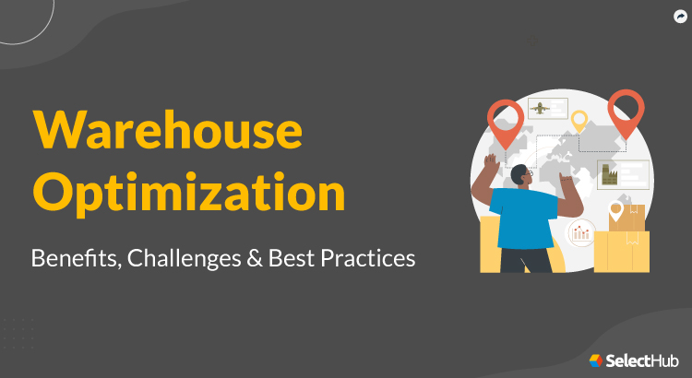
Warehouse Location Optimization System (WLOS)
A scalable, deployable and robust solution for optimization
Submitted by:
Kushagra Bhatnagar (BTECH/25097/20)
Vrindaa Malik (BTECH/25124/20)
Project Guide: Dr. Shripal Vijayvargiya
Dept. of Computer Science, Jaipur

Slide 2





Problem Statement
Customer 2
ABC Logistics Company
ABC Logistics sought to minimize costs by considering both fixed warehouse establishment costs and variable customer-reaching expenses while also ensuring facilities didn't exceed capacity.
Their overarching aim was to optimize operations for cost-efficiency while maintaining high customer satisfaction and compliance with facility capacity constraints.
Customer 1
Warehouse
Notes:
Let's consider a real-world situation: a retail company with multiple stores.
Suppose the company wants to determine the optimal placement of new stores to serve customers efficiently while minimizing costs.
In the real world, we can't have facilities with infinite capacities, there are practical limitations on the size of warehouses due to cost, and space availability.
By introducing capacity constraints, the company can ensure that each store operates optimally, within the given limitations while achieving a balance between cost-efficiency and customer satisfaction

Slide 3
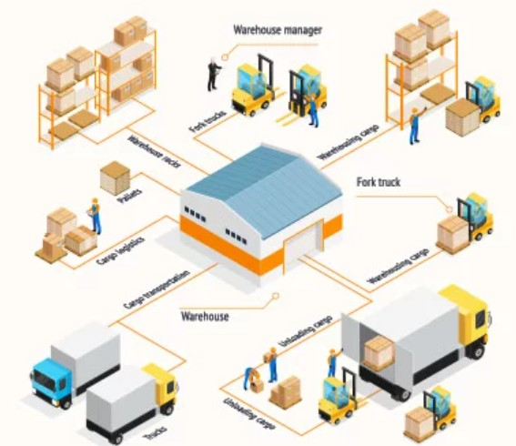
Warehouse Management
Warehouse management refers to the process of organizing, controlling, and optimizing various activities within a warehouse or distribution centre.
It involves the effective utilization of resources, such as space, labour, equipment, and inventory, to ensure smooth operations, timely order fulfilment, and efficient inventory management.

Slide 4
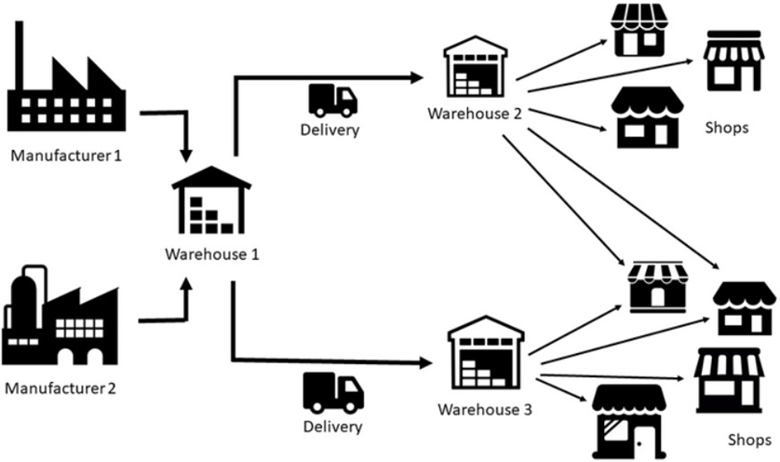
Role of Warehouse in Supply Chain
The supply chain refers to the network of organizations, activities, resources, and processes involved in producing, distributing, and delivering goods or services from suppliers to customers.
The role of warehouses encompasses their strategic positioning in inventory management, order fulfilment, consolidation, distribution, and value-added services, among others.

Slide 5
The Capacity Constraint
Let's consider a real-world situation: a retail company with multiple stores. Suppose the company wants to determine the optimal placement of new stores to serve customers efficiently while minimizing costs.
In the real world, we can't have facilities with infinite capacities, there are practical limitations on the size of warehouses due to cost, and space availability.
By introducing capacity constraints, the company can ensure that each store operates optimally, within the given limitations while achieving a balance between cost-efficiency and customer satisfaction.

Slide 6
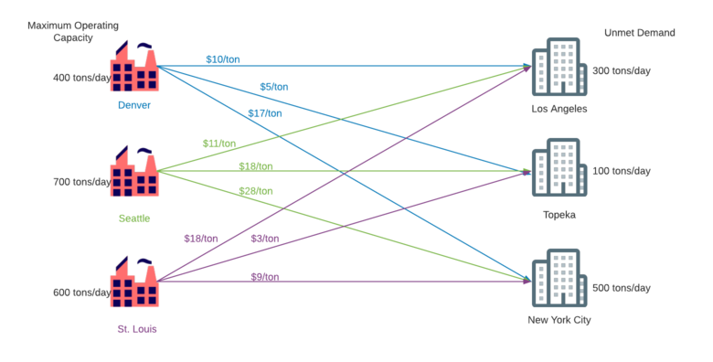
The Capacitated Problem
In facility location optimization, the capacitated constraints problem refers to the inclusion of capacity limitations for the warehouses being considered.
This means the facilities must not exceed their capacity when serving customers or fulfilling demand

Slide 7
The Example
500
400
200
Facilities F each with capacity ci and fixed cost of opening fi ∀ i ∈ F
Customers C each with demand di ∀ i ∈ C
Warehouses 1 and 2 satisfy the constraint that Σdi ≤ ci
100
1
2
800
950
300
1000
3
300
Facilities
500
Customers
400

Slide 8
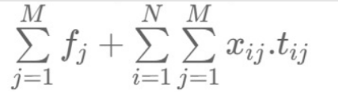
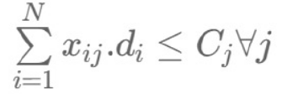
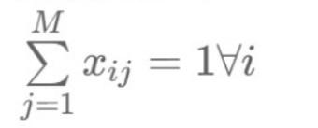
Mathematical Equations
We can pose the problem as the minimization of the following objective function.
Under the Constraints:-
M : number of facilities
N : number of customers
f_j : Fixed Cost for opening the facility
t_ij : Transport cost between customer i and facility j
x_ij : Binary variable representing whether customer i is assigned to facility j
C_j : Maximum Capacity of facility j
d_i : Demand of customer i

Slide 9
Need To Cluster
Clustering helps identify groups of customers that are geographically closer to specific warehouses. This reduces transportation costs and improves delivery times.
Clustering optimizes warehouse capacity utilization by aligning customers' demand patterns with warehouse capabilities.

Slide 10
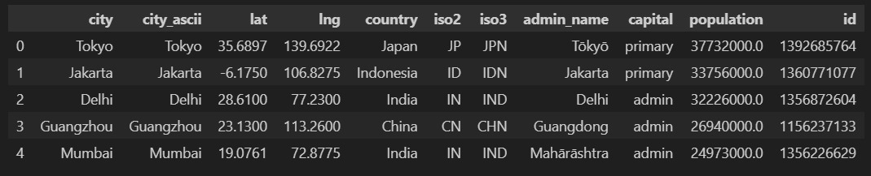
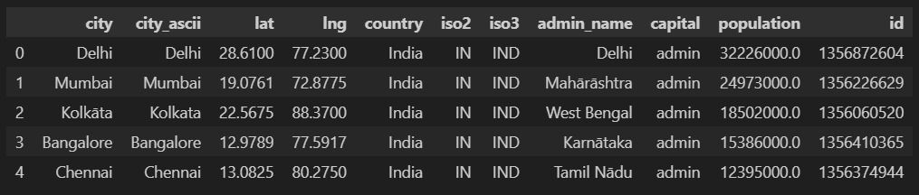
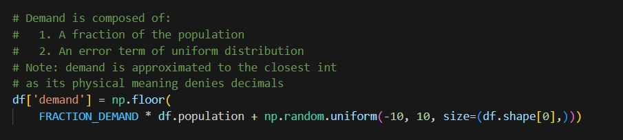
Dataset Explored
We have used the dataset from simplemaps.com.
The dataset consists of 44, 691 cities around the world.
From these cities we can filter out cities from a particular country using the iso3 code.
For the purpose of our model building, we have used the cities of Italy.
For simplicity and consistency we have eliminated the cities with population less than 10,000.
Based on the population of the cities, we have created a demand attribute.

Slide 11
Clustering Algorithms

Slide 12
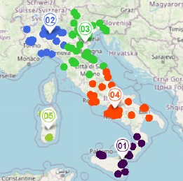
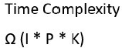
K- Means Algorithm
K-means is a popular unsupervised machine learning algorithm used for clustering data into groups.
It aims to partition a dataset into k clusters, where each data point belongs to the cluster with the nearest mean.
The algorithm minimizes the within-cluster variance by iteratively assigning data points to the nearest cluster centroid and updating the centroids based on the mean of the assigned points.
This process continues until convergence, resulting in distinct clusters with minimized intra-cluster differences.
Notes:
I- no. of iterations
P- no. of data points/customers
K- no of clusters/facilities

Slide 13
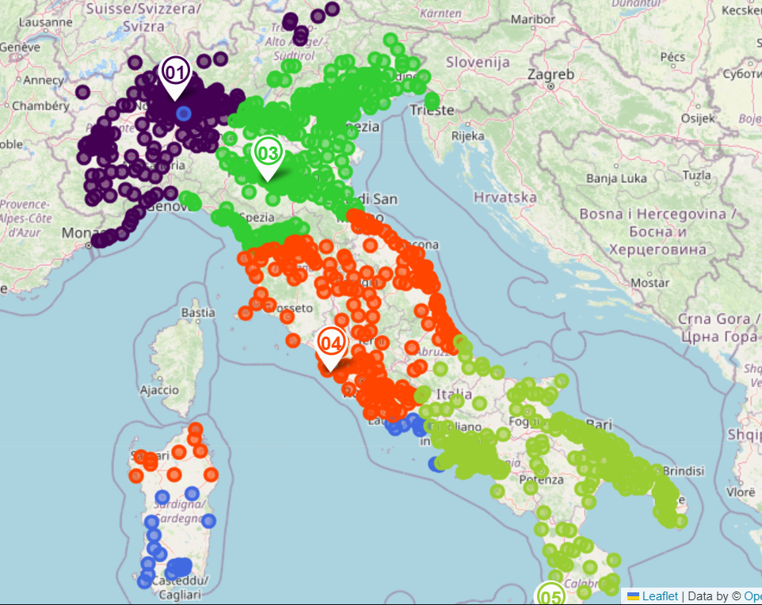
Mathematical Model using PuLP
The Objective Function along with the constraints of capacity , demand and one-user one-inventory make it an ideal Linear Programming(LP) Optimization Problem and thus Pulp can be used to solve it.
We add the objective function , the constraints required for the problem and solve this using Pulp. If the solution is feasible Pulp would return 1 otherwise -1 will be returned.
Using the Pulp method the time varies from 15 seconds to 2 minutes depending on the no. of clusters.
Time Complexity O(N*K)**2
Notes:
K = no. of facilities
N=

Slide 14

Limitations of PuLP
Speed Matters . Pulp is slow as compared to other optimization algorithms.
While Pulp can handle moderate-sized optimization problems , it may encounter difficulties when dealing with large-scale or high-dimensional problems.
It may lead to impractical computation times. Pulp cannot be given a time limit to solve a problem . It is necessary for the user to wait until the algorithm gives the solution.

Slide 15
Comparison between K-Means & PuLP
K-Means | PuLP
K-Means minimizes the distance between data points and their respective cluster centres. | Pulp aims to optimize a given objective function based on linear constraints.
K-Means by itself cannot solve the capacity constraint applied to the warehouse. | Pulp can solve the capacity constraint applied to the warehouse by using constraint equations.
K-Means can solve the problem in linear time complexity. | Pulp cannot solve the problem in linear time complexity.

Slide 16
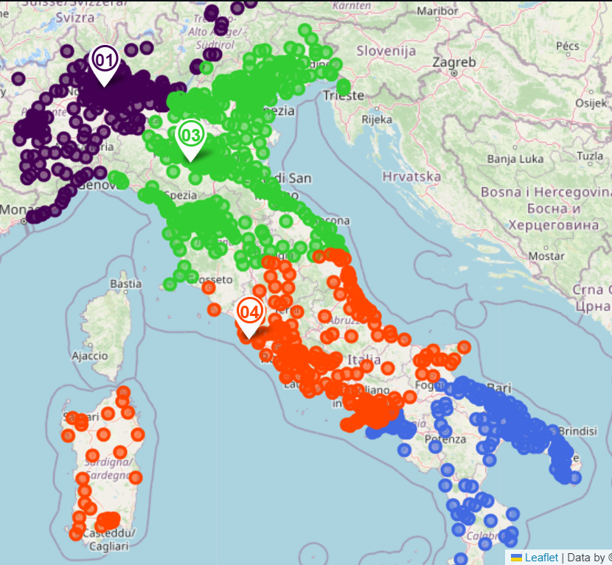
Proximity Based Local Optimisation
The Proximity-Based Local Optimization Approach entails making choices that are locally optimal at each step, emphasizing the immediate surroundings and optimizing the solution on a smaller scale, without taking into account the global implications
At every stage, the algorithm carefully chooses the facility that minimizes costs or distances in order to serve the remaining customers, taking into account capacity limitations and other pertinent factors.
By prioritizing local enhancements instead of exhaustively exploring the entire solution space, it achieves efficient outcomes within a shorter timeframe.
Time Complexity
O(N*K*I)

Slide 17
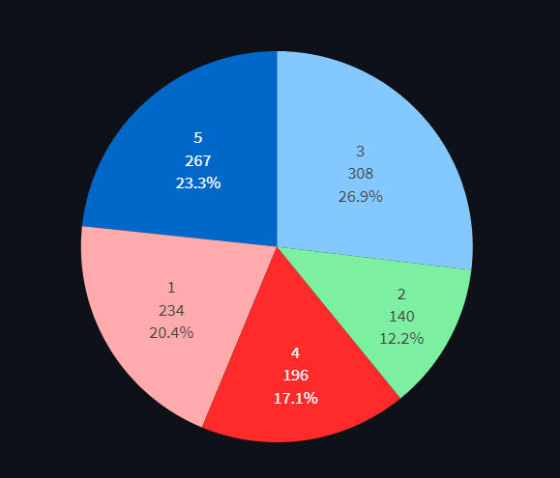
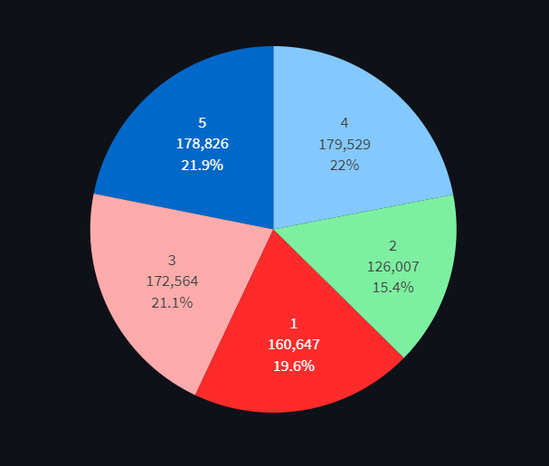
Pie Charts (To Understand To Understand The Distribution Of The Customer Along Demands)
Number of Customers per Cluster
Demand Distribution per Cluster

Slide 18
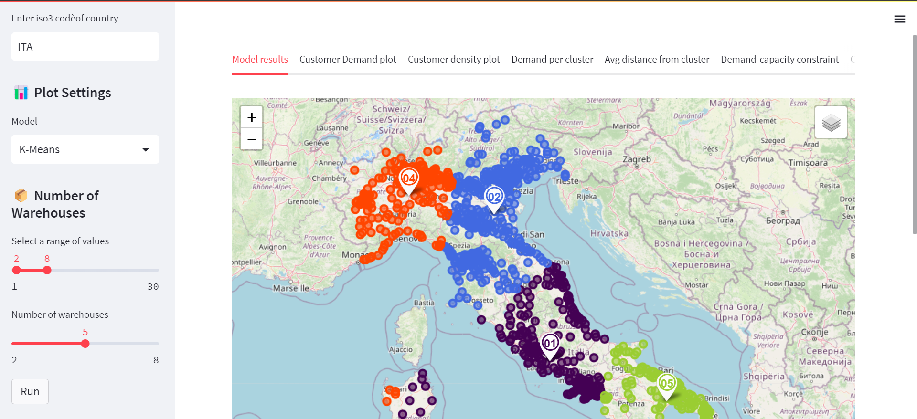
App Page

Slide 19
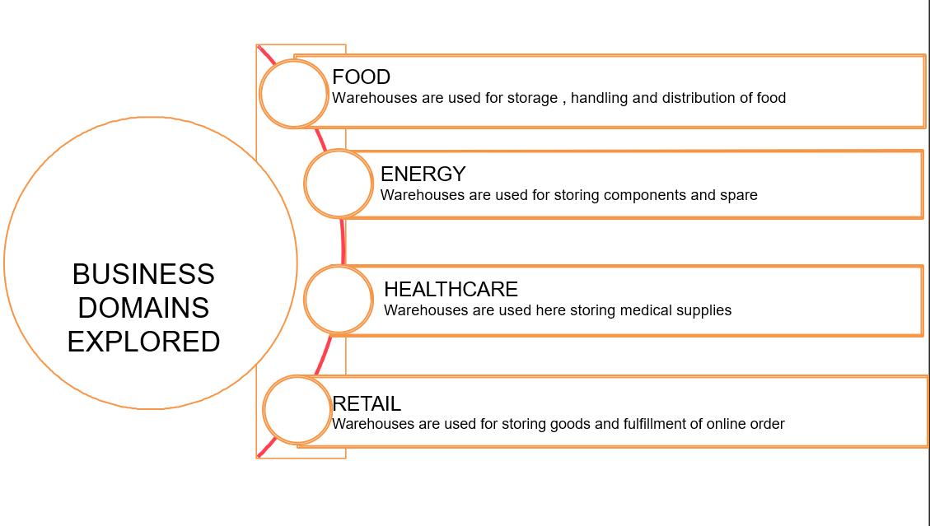




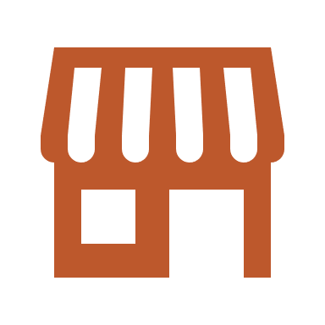

Slide 20





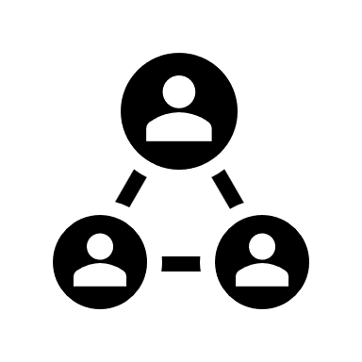

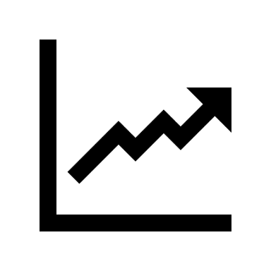

Integrating multiple data sources (GCS, Azure, AWS)
Multi-Target Optimization Solution
Auto
Mobile
Healthcare
Inventory
Planning
Reducing execution time to generate quick insights
Evaluating & Quantifying level of uncertainty
Future Challenges
Stock
Prices
Resources
Allocation
Optimisation is the need of the hour
Adding inventory management problem
Solution in the Box: Ready for deployment
Weather
Macro
Economics
Robust Pre-Processing for huge inventory values
Combination of Traditional and K-Means Clustering Algorithms
Real
State

Slide 21
Thank You!!

Slide 22
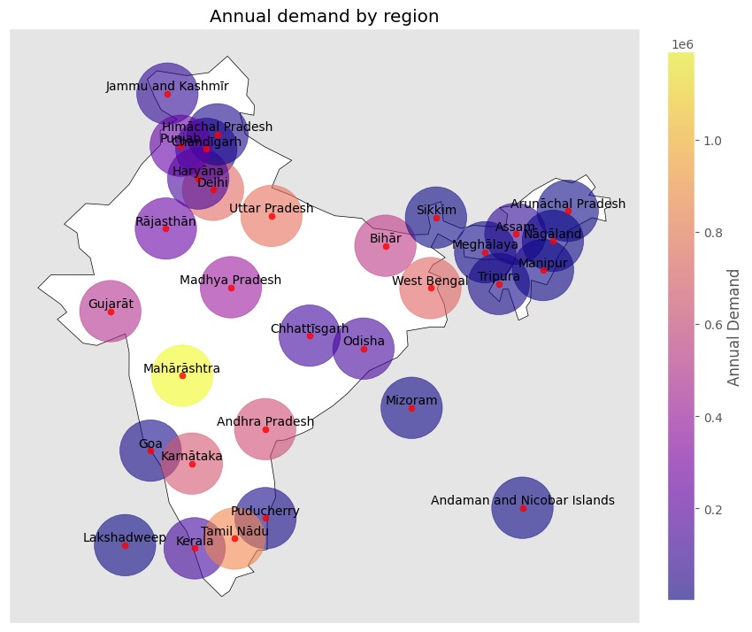
Demand Insights
After calculating the demand for every city, We aggregated the demands based on region.*
From this annual demand by region plot, we observe that the annual demand is highest in Maharashtra, followed by Tamil Nadu, Uttar Pradesh, Delhi and West Bengal.
Owing to the geographical conditions, the demand is minimum in Lakshadweep islands.
* India is divided into 30 regions by states and union territories.

Slide 23
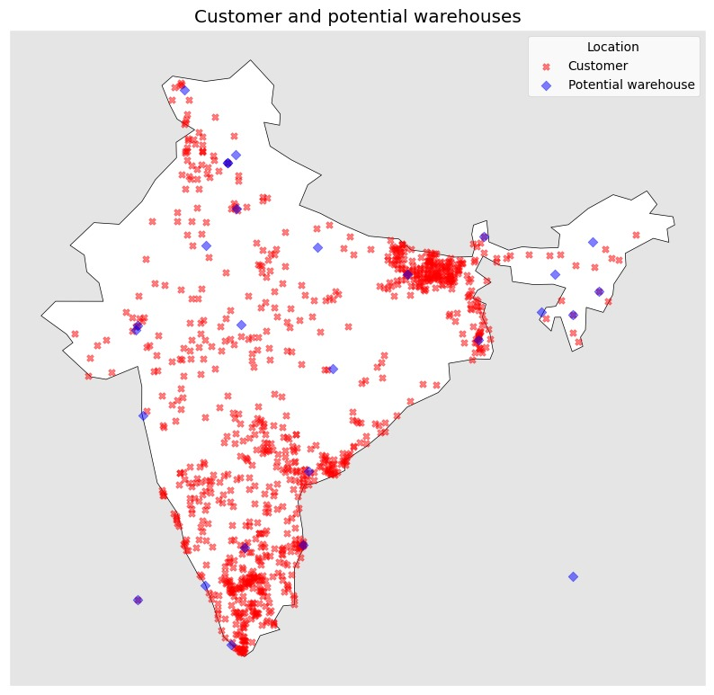
Customer Cluster
We can see the distribution of the customers across the country.
The users are spread across the entire mainland and the island as well.
Users : 4681
Potential customer locations: 910
Potential Warehouse location: 27

Slide 24
OPTIMIZATION TECHNIQUES USED
We have used K-Means clustering, to cluster the potential customer locations around different warehouses.
To further optimize the solution, PuLP optimizer was used.
PuLP is a free, open-source Python software package that can be used for optimization.
PuLP provides a modeling framework for representing mathematical formulations and problem instances in Python.
PuLP can call external LP solvers, such as CBC, GLPK, CPLEX, and Gurobi, to solve the model.
The default solver used by PuLP is the COIN-OR Branch and Cut Solver (CBC).

Slide 25
CHALLENGES
Optimal location
Optimal warehouse levels and location
Optimization
Optimization
involves maximizing or minimizing a certain objective.
Cost Reduction
Reduce variable costs like transport, holding, and shortage
Notes:
In facility location optimization, the capacitated constraints problem refers to the inclusion of capacity limitations for the warehouses being considered.
This means the facilities must not exceed their capacity when serving customers or fulfilling demand. constraints: Time, Distance and Capacity

